Slide 1
Recommendation System of Locations for Opening a New Italian Restaurant
Nouman Aftab
nom.aftab@gmail.com

Slide 2
Background
In the world of business, it is observed that running a restaurant is much beneficial and lasts for decades. But about 90% of the restaurant setups fail to gather required number of customers to remain in business. There are many factors which are needed to be stressed before opening a new restaurant. One of them is the “right location” for new installation which still have too many things to focus on in itself.

Slide 3
Problem for stakeholder
Selection of a new location for opening a restaurant in an unfamiliar city is totally a risk which needs too much
Efforts
Time
Expenses
Collaborations
Information
Decision making.

Slide 4
Stakeholders
Local businessman
Foreign investor/businessman
Entrepreneur
Researcher

Slide 5
Data Acquisition
Sr. No. | Feature | Dataset Link
1. | Population & Density | https://en.wikipedia.org/wiki/Demographics_of_Toronto_neighbourhoods
2. | Average Income of Neighbourhood | https://en.wikipedia.org/wiki/Demographics_of_Toronto_neighbourhoods
3. | Crime Rate | http://data.torontopolice.on.ca/datasets/neighbourhood-crime-rates-
4. | Recreation Places in Neighbourhood | Foursquare.com
5. | Employment in Neighbourhood | http://map.toronto.ca/wellbeing
6. | Commuting on any Transport | https://en.wikipedia.org/wiki/Demographics_of_Toronto_neighbourhoods
7. | Percentage of Relevant Population | https://en.wikipedia.org/wiki/Demographics_of_Toronto_neighbourhoods
8. | Postcode, Latitude & Longitude | http://cocl.us/Geospatial_data
9. | Postcode, Boroughs & Neighbourhood | https://en.wikipedia.org/wiki/List_of_postal_codes_of_Canada:_M
 | Total Distinct Dataset Links | 6

Slide 6
Data Cleaning
Many functions are utilized for cleaning the data like
Split
Strip
Replace etc.
Data with NaN (not a number) is replaced with zero or the tuple is removed based on the dataset requirement
Redundancy is addressed

Slide 7
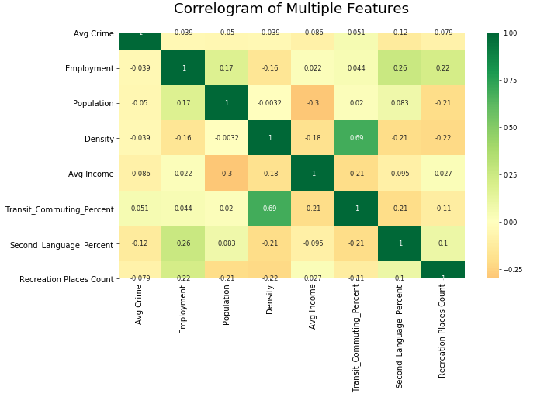
Exploratory Data Analysis

Slide 8
Pearson correlation coefficient and ANOVA Test
Pearson correlation coefficient
Correlation coefficient = 0.69
p-value is 7.939413292581887e-10
ANOVA Test
F-value = 5.514682857019
p-value = 0.02052128232031738

Slide 9
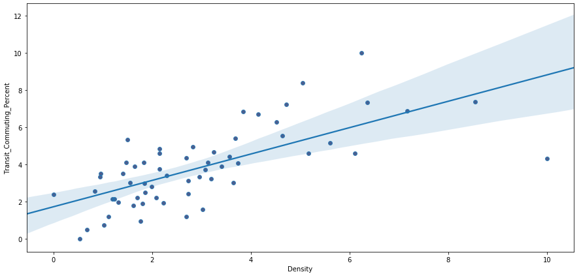
Density vs Transit Commuting Percent (Feature Drop)

Slide 10
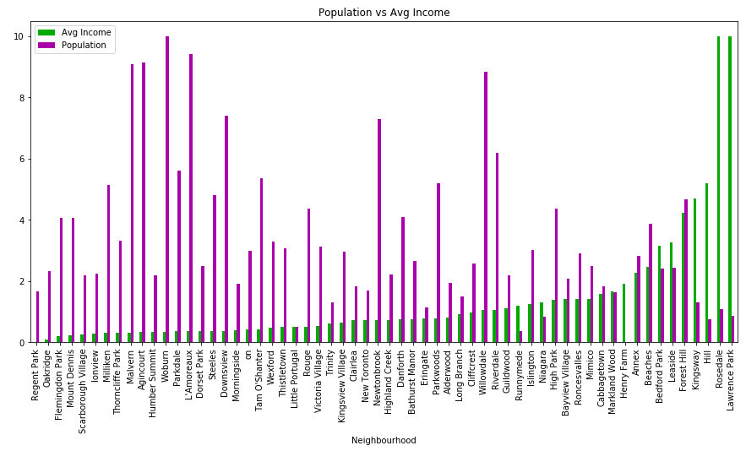
Population vs Average Income

Slide 11
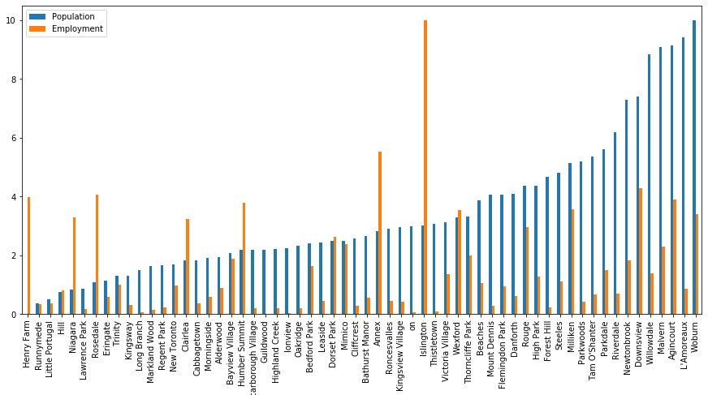
Population vs Employment

Slide 12
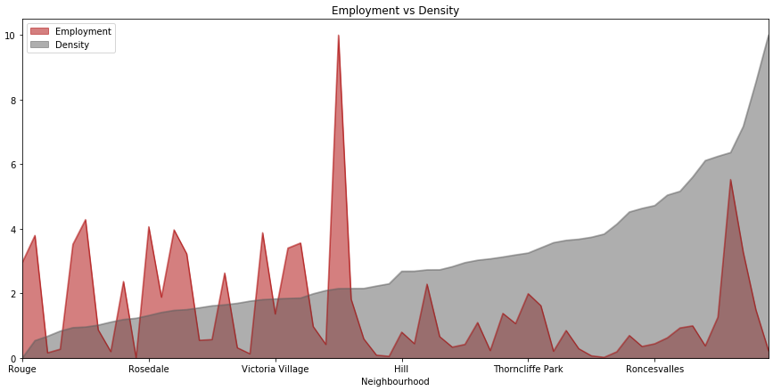
Employment vs Density

Slide 13
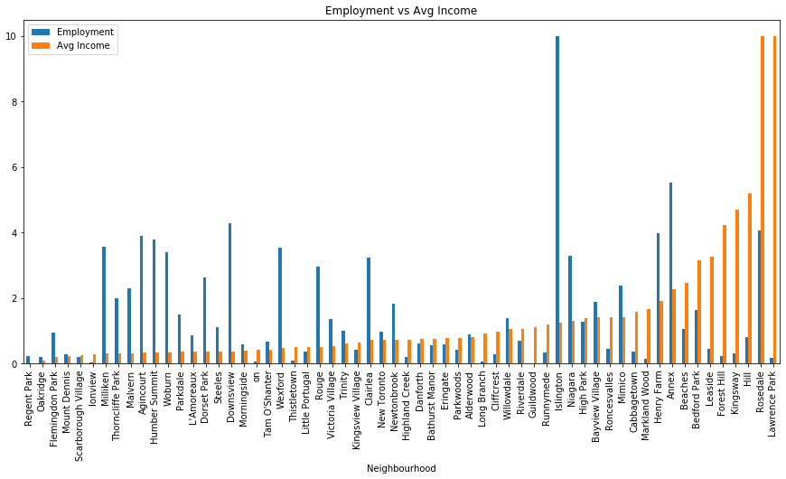
Employment vs Average Income

Slide 14
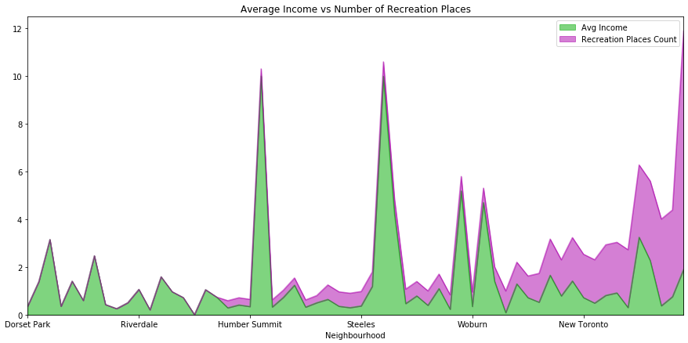
Average Income vs Total Recreation Places

Slide 15
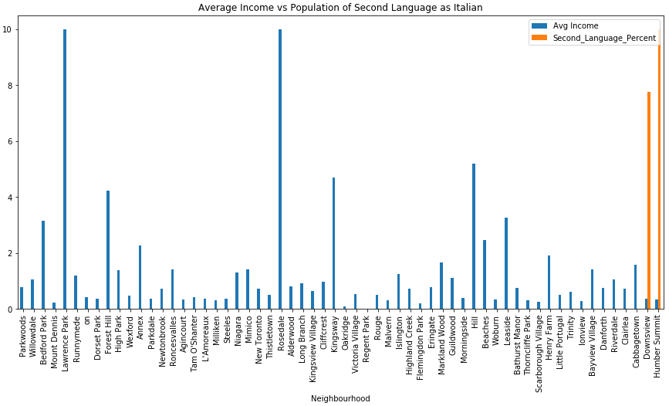
Average Income vs Second Language Percent

Slide 16
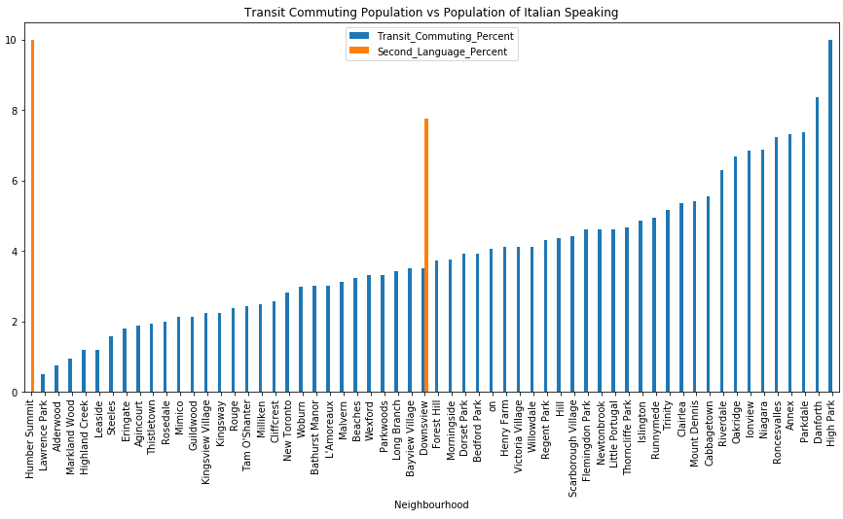
Transit Commuting Percent vs Second Language Percent

Slide 17
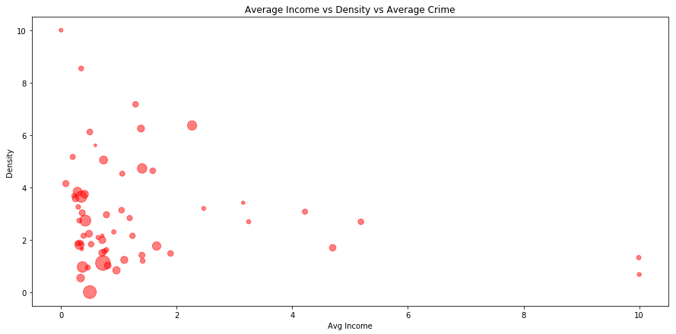
Average Income vs Density vs Average Crime

Slide 18
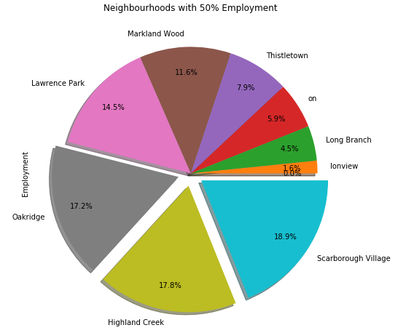
Neighbourhood Offering Major Portion of Employment
Ten neighbourhoods cover 50% of the employment
Oakridge, Highland Creek and Scarborough Village cover even further 50% of the employment among the ten

Slide 19
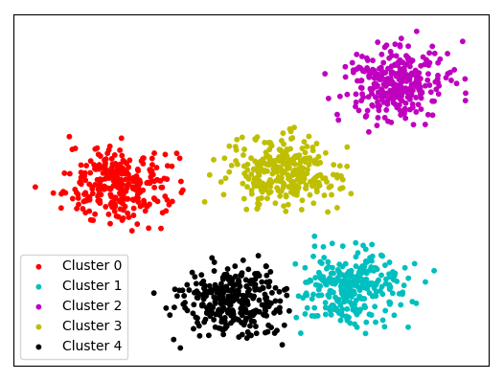
Clustering

Slide 20
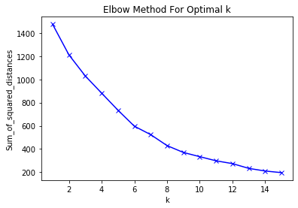
Optimal “k” for clusters

Slide 21
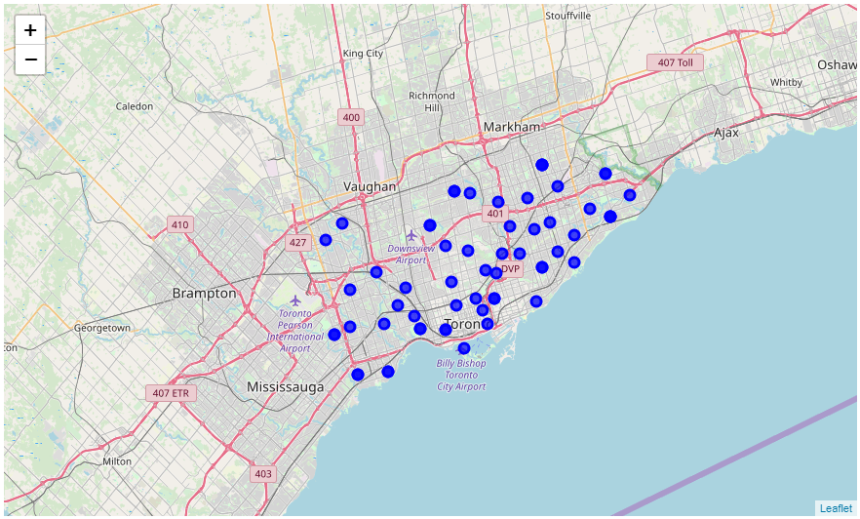
Neighbourhood with Complete Data, Toronto Map

Slide 22
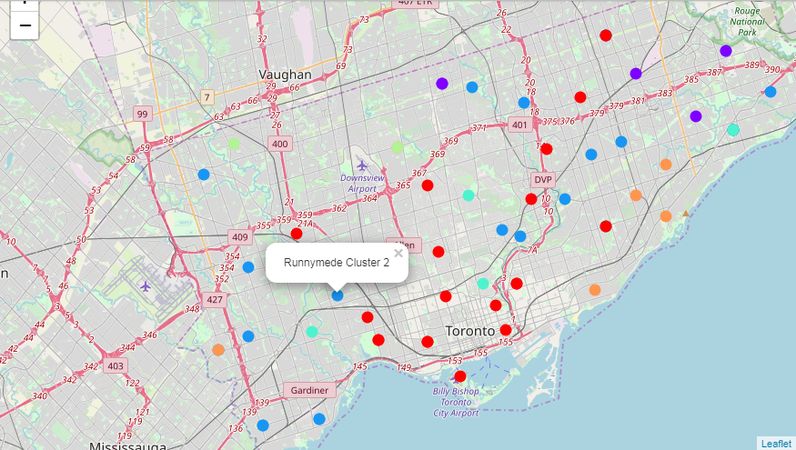
Clustering Result

Slide 23
Weighed Clustering
Required Avg Crime in Neighbourhood = low
better the safety more people for outing
Required Employment in Neighbourhood = high
so people could more likely to go to restaurant
Required Population in Neighbourhood = high
more population more crowd in restaurant
Required Density in Neighbourhood = high
more density more crowd in restaurant
Required Avg Income in Neighbourhood = high
to spend more
Required Second Language Percent in Neighbourhood = high
more Italian people good chance of selling
Required Recreation Places in Neighbourhood = high
more pedestrian more selling

Slide 24
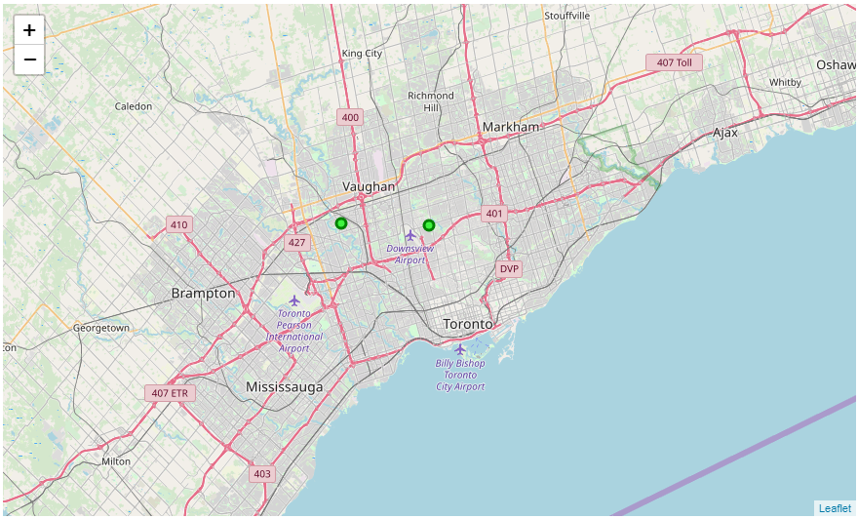
Recommended Locations

Slide 25
Conclusion & Future Work
Acquisition of multiple, related data to recommend the best locations for opening an Italian restaurant in Toronto.
Web scraping and API are used to get/extract data
Pearson correlation coefficient and ANOVA tests utilized to remove extra feature
K-Means clustering technique used to get weighted clusters
Elbow Method used for optimal cluster
Total 60 Neighbourhood obtain whose number could be increased by renaming and matching manually
Further features like real estate prices etc. can be used to enhance the system

